Slide 1
HISD Summer School Professional Development Session Survey Analysis
Presented by: Jennifer McNew
March 2026

Slide 2
Project Overview:
This analysis examines 1,149 professional development session survey responses collected during HISD's Summer School PD program.
The dataset includes participant feedback across 5 dimensions:
Clarity,
Value,
Engagement,
Confidence,
Preparedness.
Sessions were facilitated by 31 facilitators across elementary, middle, and high school grade bands, covering 10 content categories.

Slide 3
Methodology:
Data Source: Summer School PD Session Survey (1,149 responses, 15 columns)
Tools Used: Power BI Web via Microsoft Fabric
Steps Taken:
Imported CSV data and performed Power Query transformations including column renaming and data type validation
Standardized 164 unique Content Focus entries into 10 meaningful content categories using DAX SWITCH/CONTAINSSTRING logic
Created shortened session name labels for improved visual clarity
Built interactive 3-page dashboard with slicers for Grade Level Band, Facilitator, and Content Category
Challenges Overcome:
Navigated Power BI web version limitations on Mac without Desktop access
Resolved Microsoft Fabric infrastructure error (LargeModelMovedAcrossRegions) by managing semantic model storage format settings
Adapted workflow to use native Power BI aggregations as workaround when DAX measures were unavailable due to infrastructure constraints

Slide 4
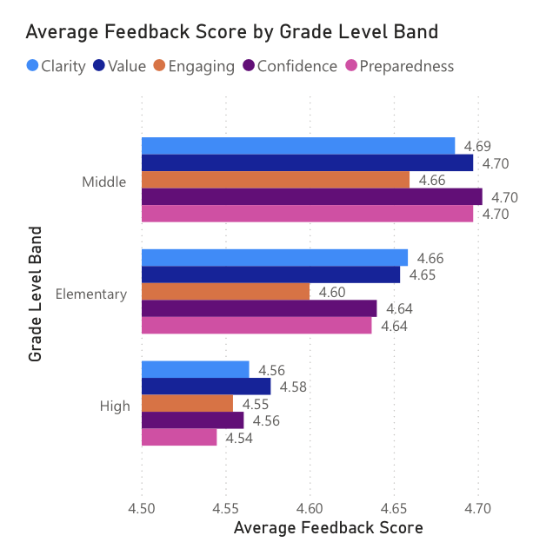
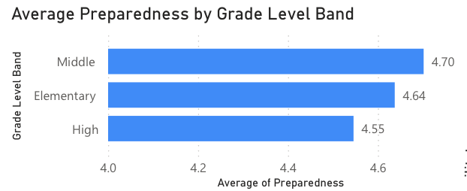
Key Finding 1: Grade Level Disparities
Overall district average feedback score: 4.62 out of 5.0
Key Insight: High school participants consistently rated PD sessions lower across both overall feedback and preparedness scores. The 0.13 point gap between Middle and High school suggests high school teachers may have different or more specialized PD needs that current sessions are not fully addressing.
Recommendation: Develop differentiated PD content specifically designed for high school instructional contexts.

Slide 5
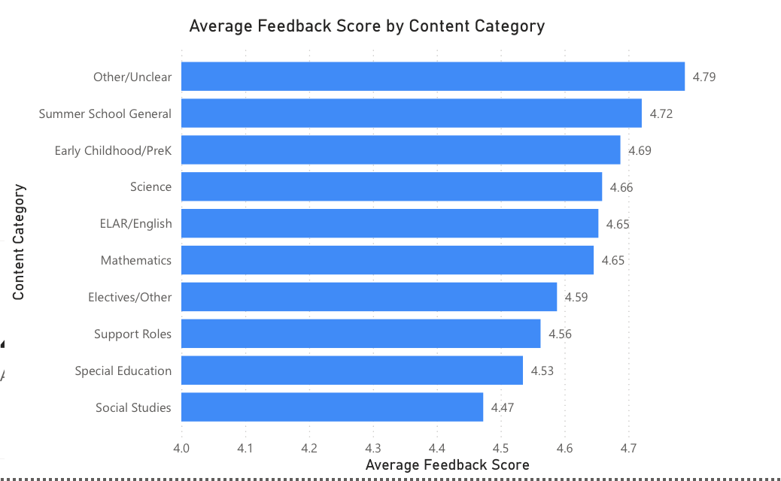
Key Finding 2: Content Category Performance
Key Insight: Social Studies and Special Education consistently scored below the district average. The 0.28 point spread across content categories indicates meaningful variation in PD quality and relevance by subject area.
Recommendation: Review and redesign Social Studies and Special Education PD content. Consider using Summer School General sessions as a model for other content areas given their highest satisfaction rating.

Slide 6
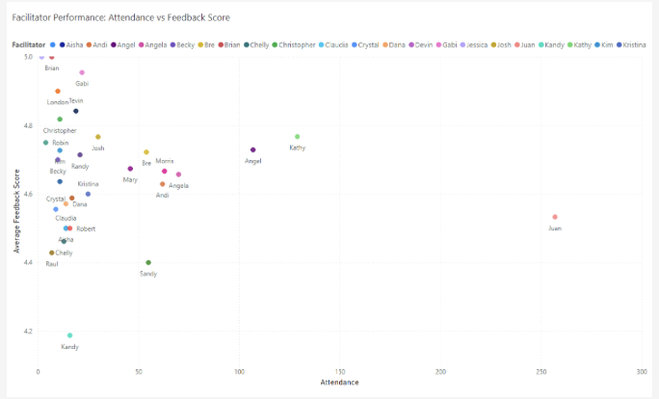
Key Finding 3: Facilitator Performance
Top Performers (minimum 10 participants):
Kathy — 4.74 (129 participants)
Angel — 4.68 (107 participants)Angela — 4.67 (70 participants)
Josh — 4.67 (30 participants)
Facilitators Needing Support:Raul — 4.14 (7 participants)
Robert — 4.31 (16 participants)
Claudia — 4.36 (14 participants)
Note: Facilitators with fewer than 10 participants excluded from performance comparison due to insufficient sample size for meaningful analysis.
Key Insight: Juan facilitated 22% of all sessions (257 participants), primarily at the high school level. His preparedness score of 4.52 is consistent with the district-wide pattern of lower scores at the high school grade band, suggesting his results reflect the challenges of high school content PD rather than facilitation quality. Analysis should control for grade level before drawing conclusions about individual facilitator performance.
Recommendation: When evaluating facilitator performance, disaggregate scores by grade level band to ensure fair comparison. A facilitator working exclusively with high school teachers should be benchmarked against other high school facilitators, not the district-wide average.

Slide 7
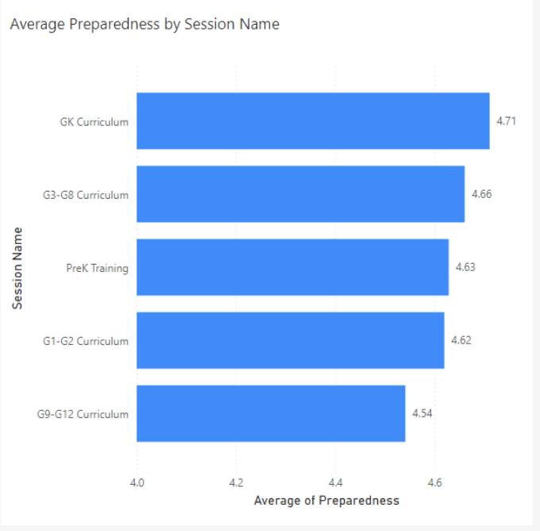
Key Finding 4: Session Analysis
Key Insight: G9-G12 Curriculum sessions scored lowest on preparedness (4.54) — consistent with the high school grade band finding. This confirms that high school PD sessions need targeted improvement, not just at the facilitator level but at the curriculum design level.
Recommendation: Redesign G9-G12 curriculum content and review facilitator assignments for high school sessions.

Slide 8
Recommendations: Grade Level & Content
Differentiate PD for high school teachers — High school participants consistently scored lower on both feedback (4.56) and preparedness (4.54). Develop PD content specifically designed for high school instructional contexts.
Redesign Social Studies and Special Education PD content — Both scored below district average (Social Studies 4.45, Special Education 4.51). Review curriculum design and facilitator assignments for these areas.
Use Summer School General and PreK sessions as models — Highest rated sessions (4.73 and 4.70) should inform redesign of lower-performing content areas.

Slide 9
Recommendations: Facilitators
Implement facilitator support for lowest performers — Raul (4.14), Robert (4.31), and Claudia (4.36) would benefit from coaching or mentoring.
Control for grade level in facilitator evaluations — Facilitators working primarily with high school teachers should be benchmarked against other high school facilitators, not the district-wide average.
Review high-volume facilitator workloads — Monitor quality vs. quantity tradeoffs for facilitators with disproportionately high session loads.

Slide 10
Recommendations: Data Collection
Redesign G9-G12 curriculum content — Lowest preparedness scores at the session level confirm high school PD needs improvement at both the facilitator and curriculum design level.
Restructure Content Focus data collection — Replace free-text field with a dual-field approach:
Content Category (dropdown) for standardized reporting
Exact Course Title (free-text) for deeper drill-down analysis

Slide 11
Data Quality: Strengths
Overall Assessment: Strong
The high completion rate across all required fields reflects effective data collection practices and supports confidence in the findings presented in this analysis.
100% Field Completion Across All 1,149 Responses:
Facilitator — fully completed
Campus Name — fully completed
Key Lesson and Implementation — fully completed
Clarity, Value, Engaging, Confidence, Preparedness — all fully completed
This level of data completeness is a positive indicator of survey design effectiveness and participant engagement with the PD program evaluation process.

Slide 12
Data Quality: Opportunities & Recommendations
Opportunity for Improvement:
Content Focus was collected as free-text, resulting in 164 unique entries requiring significant standardization during analysis
Recommendation — Restructure Content Focus into two fields:
Content Category (dropdown) — Standardized categories such as Mathematics, ELAR/English, and Science for consistent high-level analysis and reporting
Exact Course Title (free-text) — Preserves ability to drill down into individual course performance when needed
This dual-field approach improves data standardization and reduces analytical burden while maintaining the flexibility needed for deeper investigation. Implementing this change before the next PD cycle would significantly reduce post-collection processing time and enable more granular reporting across content areas.

Slide 13
Project Log: Challenges & Solutions
Challenge 1 — Platform Limitation: No access to Power BI Desktop on Mac. Adapted entire workflow to Power BI web via Microsoft Fabric, including alternative DAX syntax and manual column management.
Challenge 2 — University Tenant Restrictions: Account defaulted to Viewing mode. Identified and resolved via Editing toggle in report interface.
Challenge 3 — Microsoft Infrastructure Error: Large semantic model storage format caused LargeModelMovedAcrossRegions error (HTTP 400). Resolved by disabling large semantic model storage format setting and rebuilding model.
Challenge 4 — Data Standardization: 164 unique free-text Content Focus entries required custom DAX SWITCH/CONTAINSSTRING formula to categorize into 10 meaningful groups.
Challenge 5 — Data Quality Investigation: Apparent blank values in slicers investigated through DAX queries — confirmed as Power BI display artifacts, not actual missing data. All required fields 100% complete.

Slide 14
Conclusion
Overall, HISD's Summer School PD program received strong feedback with a district average of 4.62 out of 5.0.
However, meaningful variation exists across grade levels, content areas, and facilitators that presents opportunities for targeted improvement.
High school participants and Social Studies/Special Education content areas represent the greatest opportunities for PD enhancement.
Implementing the recommendations above would help ensure all HISD teachers receive equitable, high-quality professional development regardless of grade level or content area.

Slide 15
Appendix: Data Overview
Total Responses: 1,149
Total Facilitators: 31
Total Campuses: 27
Grade Level Bands: Elementary (650, 56%), High (312, 27%), Middle (185, 16%)
Content Categories: 10 standardized from 164 unique entries
Session Types: 5 (G1-G2, G3-G8, G9-G12, GK Curriculum, PreK Training)
District Avg Overall Feedback: 4.62
District Avg Preparedness: 4.62
Feedback Score Range: 4.45 (Social Studies) — 4.73 (Summer School General)
Preparedness Score Range: 4.14 (Raul) — 5.00 (Brian/Devin/Jessica/Robin)

